Slide 1


AN INITIATIVE OF
THE CHURCH OF PENTECOST YOUTH MINISTRY
PRESENTATION BY:
GORDON ANSAH (PASTOR)
TS – UPPER WEST SECTOR

Slide 2
ACKNOWLEDGEMENT
Youth Director, Ps. Ebenezer and Mrs Priscilla Hagan
The entire National Executive Committee (NEC)
All Youth Workers

Slide 3




BOOK TITLE
FOLLOWING EMBODDIED DISCIPLESHIP IN A DIGITAL AGE

Slide 4


ABOUT THE AUTHORS: Lessons
Jason Byassee and Andria Irwin (Intergenerational authors, a concept worth-imitating by Youth Workers).
Jason had been a prolific writer for several blogs and Christian Media Houses before becoming a Pastor.
For Andria, it is her first time writing a book. She was born as a digital native, used her technological prowess but Jason tapped her abilities to focus them into the book.

Slide 5
OUR APPROACH OF PRESENTATION
Present Summary from the Book
Share implication for our context as Youth Workers

Slide 6

CHAPTERS OF THE BOOK
Introduction: The End is Near
Putting on the New Self
A Pastoral Personality
The Opposite of Technology
Jesus’s Own Family
Undistracted Friendship
The Internet is (Kind of) a Place
Virtual Virtue
Daring to speak for God
Conclusion: No Unmediated God

Slide 7

Introduction
The Christian Response to new technologies is that the end is near
“Critics of the web point out that the world’s best engineers have designed these systems to addict us”

Slide 8
Chapter 1: Putting on the New Self
Col. 3:10 – Put on the new self (first to acclimatize with the new tech environment; secondly to show our new self of Christlikeness even online, and third be Christ advocate online).
Initial anonymity not there due to IP addresses, one could be found in IRL (In Real Life) – caution to youth workers
Our Ministry as Youth Workers are to young people of postmodernity who are Gen Y (1981-1996); 26-41yrs, Gen Z (1996-2012); 10-25yrs , and Gen Alpha (2013-2025) – digitally smart generations

Slide 9
Chapter 1: Putting on the New Self Contd.
These generations converse with a lot of acronyms eg. ASAP (As Soon As Possible), MIA (Missing In Action), FOMO (Fear Of Missing Out), YOLO (You Only Live Once), BRB (Be Right Back), TMI (Too Much Information)
The Call is that we can use the digital space to disciple and to cause change. With over 3.4 billion on Social Media, the Church can get into the social media space. On Social Media, “the holy greets the profane”.
We must speak on Social Media

Slide 10
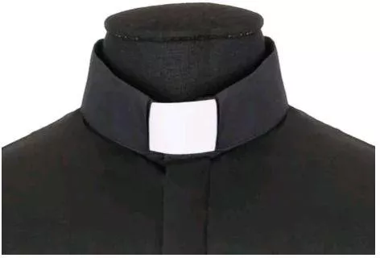
Chapter 2: A Pastoral Personality
Should a Minister (Youth Worker) have Personal Social Media Accounts?
Ministers of God must let their weight be seen as such on the Social Media Space but NOT to fall prey to sexual misconduct, systemic racial discrimination, unnecessary theological warfare, etc.
The Pastor’s identity is to be faithful to the pulse of the Spirit and to the continuously shifting culture it inhabits. We have to use technology to hear the needs of the people and we have to inhabit technology to provide what the people might need.

Slide 11

Chapter 3: The Opposite of Technology
The Opposite of Technology is physical or local meetings.
Long distance correspondence is no substitute for face-to-face friendship, meals together, mutual prayer and worship and laughter and bodily touch, baptism and eucharist. Digital communication is no substitute for, but rather a supplement to, embodied presence
We must adopt the hybrid mode.

Slide 12
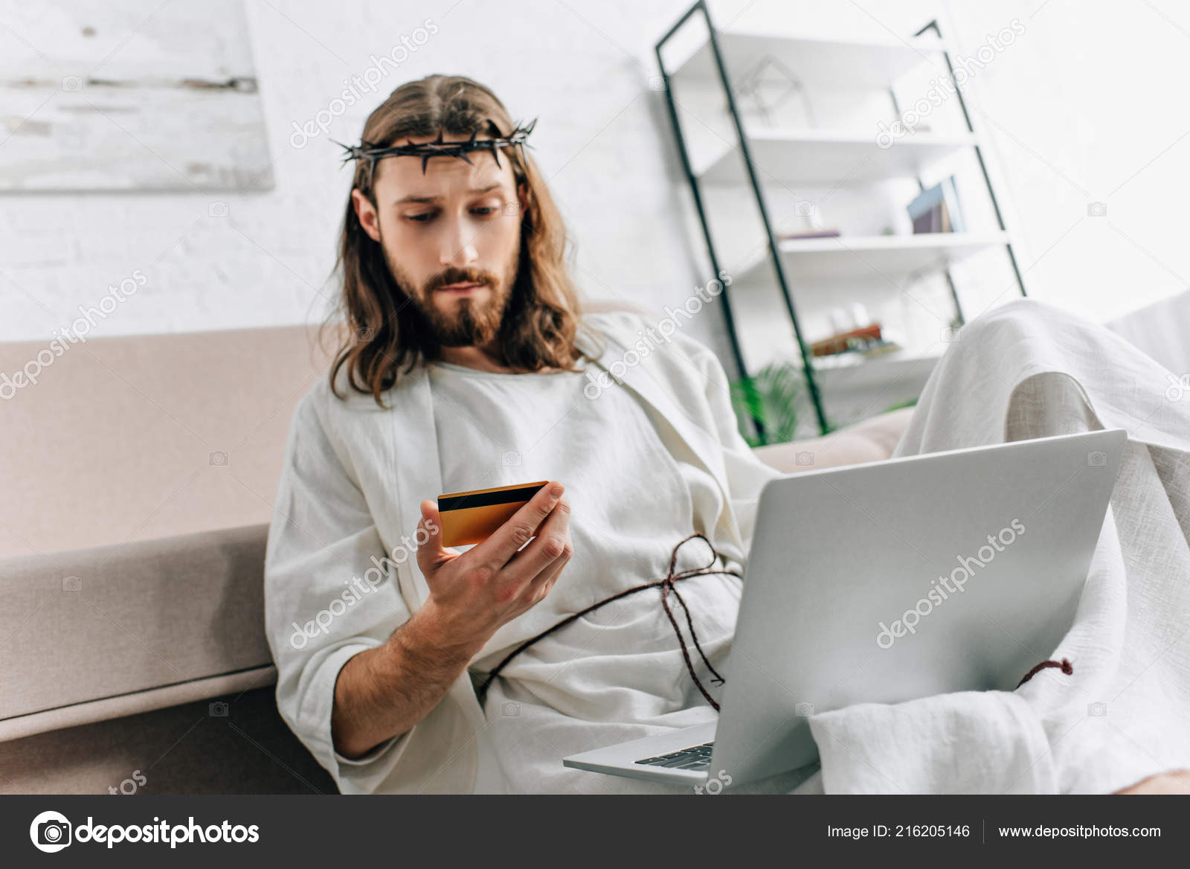
Chapter 4
Jesus’s Own Family
A common charge against digital revolution is that it affects families
Jesus somewhat gave a new definition of nuclear family (Mark 3:33-35)
Technology can disrupt biological families – Eg. Of elder mom and her digital-native daughter, sitting together, one ignored, the other texting away.

Slide 13
Chapter 4: Jesus’s Own Family Contd.
Technology can make us feel omnipresence. Christians (Youth Workers) should be able to spot a false doctrine when they see one.
Technology is there to serve us (servant), rather than be our master

Slide 14
Chapter 5: UNDISTRACTED FRIENDSHIP
I have much to write to you, but I do not want to use paper and ink. Instead, I hope to visit you and talk with you face to face, so that our joy may be complete. – 2 John 12
Digital technology affects our relationships through the façade of connection, reliability and steadfast union.
Behind the façade is the hard truth that relationships are not flourishing. The new culture also promotes loneliness and ill-commitment.
The best model of friendship – Jesus and his disciples. Their friendship require trust, commitment, endurance, intimacy, honesty, physical presence & autonomy.

Slide 15
Chapter 6:THE INTERNET IS (KIND OF) A PLACE
The internet with all its residents, is a mission field. We can make disciples there too
Matthew 28:19

Slide 16
Chapter 7: VIRTUAL VIRTUE
Human beings have always had technology – homo faber, we create things
Can the Christian celebrate the Eucharist online? Quite impossible prior to COVID-19
Jesus asks us to remember (Luke 22:19) – the Greek is anamnesis which means ‘experience anew’.
Technology also comes with false teachings. “A claim that, a new era has arrived, a dawn in which we can be liberated from all that ails us. No – only God does that through the cross of Christ.”
Our current digital revolution, leaves us all in a continuous state of partial attention.
Young people are using the screens in their pockets as their counsellors, their entertainers, their instructors, and even their sex educators. Older Christians need to spend time young people as models.

Slide 17



Chapter 8: DARING TO SPEAK FOR GOD
The Word is alive; it is near you, on your lips, and in your heart (Deut. 30:14)
Preaching on the saving grace of God through Christ can happen through our digital devices.
Online preaching is not limited to churchly programming but for the benefit of the whole world, the healing of the nations, and remaking of the universe.
My Personal Experience with Facebook Community Help

Slide 18

Conclusion: UNMEDIATED GOD
The God of the Bible loves mediation (have direct access to us through Christ. God dwells with His people and expects that we will be in community with others to achieve discipleship. For this reason, the material discourages individualism which is made worse by gadgets – high screen times with ourselves alone without recourse to others.

Slide 19

Lessons for Our Context
As Youth Workers, we can make use of our social media platforms for evangelism and discipleship: WhatsApp (Messaging and status), FB – story, post, private messaging; Twitter – our tweets; we need to make efforts here, TikTok, snapchat etc. But we need to grow our following to be more impactful. Other strategizes.
We can use these platforms to provide regular discipleship and to sometimes know when are members are in danger.
To prepare adequately and ensure quality output if we are to stream messages online.
We may also adopt and share short videos of sermons from Chairman, Director, and from any of us

Slide 20
Lessons for Our Context
We may adopt digital communication to reach our members when they are in school and especially overseas study – They may be battling loneliness and our contacts may just be timely. It is also a good opportunity for discipleship.
Re-emphasize the Small Group concept of the Youth Ministry where meetings could adopt a hybrid approach.
During our intergenerational services, we can advocate for topics that will ensure uninterrupted family times spent together.

Slide 21
Lessons for Our Context
The need to be disciplined online even when we are in personal conversations to avoid courting troubles for ourselves
We can design a topic about responsible use of Social Media and teach it to our young people
Give undivided attention during Youth classes, meetings & programmes

Slide 22


THANKS & GOD BLESS YOU

